Slide 1
Pattern Recognition
Chapter 4: Estimation and Learning _part II

Slide 2
Outline
Motivation
Non-parametric Learning
Histogram Estimation
Parzen Window Estimation
K-Nearest-Neighbor Estimation

Slide 3
Motivation
So far, all of the model learning methods have been based parametric estimation, where functional form of PDF is assumed to be known and the necessary parameters of the PDF are estimated.
However, in many pattern recognition problems:
  The functional form of the PDF is not known, or
  The statistical distribution cannot be well modeled using parametric PDF models (i.e., p(x|θ))
Solution: we need to directly estimate the class distribution p(x) from the samples {x_{i}}!
Such methods are called non-parametric estimation methods.

Slide 4
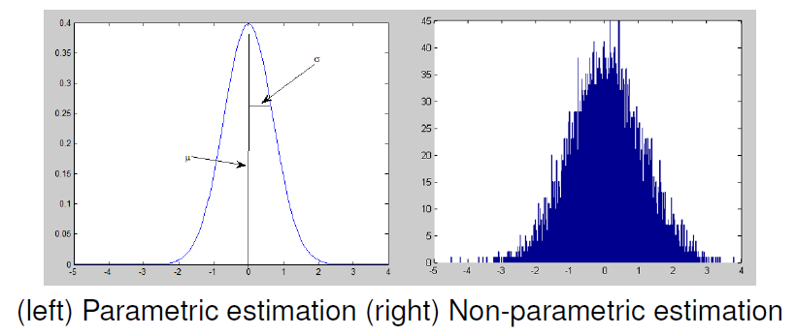
Motivation

Slide 5
Non-parametric Learning
Here, we assume that we do not know ANYTHING about the class conditional probability function.
All we are given are N samples x_{i}, which are labeled so we know that they belong to a single class.
In this scenario, what we want to do is estimate the distribution directly based on a set of labeled samples for the class!
Here, we will focus on learning a single class from labeled samples. In practice, we need to learn multiple distributions based on samples with different class labels.
All we need to do is just run the non-parametric learning process multiple times, once for each class.

Slide 6
Types of Non-parametric Estimation
There are three main categories of non-parametric estimation approaches:
Histogram estimation: Group labeled samples into discrete regions to approximate p(x)
Parzen window estimation: Approximate p(x) in a continuous manner based on the local contribution of each sample thus controlling resolution along x-axis explicitly.
kNN Estimation: Approximate p(x) in a continuous manner based on contribution of nearest neighbor samples, thus controlling resolution along PDF axis explicitly, with resolution along x-axis data dependent.

Slide 7

Histogram Estimation
The simplest approach to non-parametric estimation of p(x) is just constructing the normalized histogram!
Why is this true?
Consider some interval R=[a,b]
If p(x) is constant over this region, then
Notes:
这个部分没看懂！为什么是ML估计而不是贝叶斯估计呢？

Slide 8

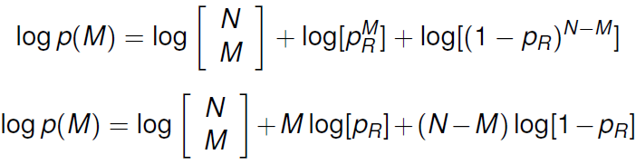
Histogram Estimation
Suppose that we have N samples x₁,…,x_{N} taken from PDF p(x)
The number of samples M that fall within region R must obey a binomial distribution:
Taking the log gives us:

Slide 9
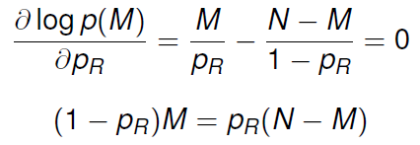

Histogram Estimation
Taking the derivative and setting to zero:
This gives us the ML estimate of p_{R} as:

Slide 10

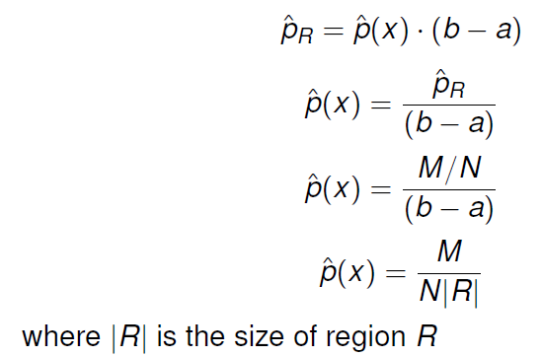
Histogram Estimation
Recall that:
Plugging our ML estimate for p_{R} gives us:

Slide 11

Histogram Estimation: Steps
Given a set of bins R_{i}:
  1) Count the number of samples M_{i} that falls into each bin i
  2) Count the total number of samples N
  3) for a particular pattern x, p(x) can be computed as :
What this means: For a particular pattern x, find which bin i it belongs to (R_{i}), and compute the ratio between the number of samples in that bin (M_{i}) and the total number of samples N times the region size |R|

Slide 12
Histogram Estimation
There is a fundamental tradeoff between resolution along x and resolution along p(x):
  For good resolution along x, we want to have small-sized regions. However this leads to small M_{i}, thus poor PDF resolution.
  For good resolution along p(x), we want to have large M_{i}, and thus large-size regions. However this leads to poor x resolution.
Other major disadvantages:
  Estimated PDF is ALWAYS discontinuous.
  Shifting origin changes the shape of the estimated PDF.

Slide 13
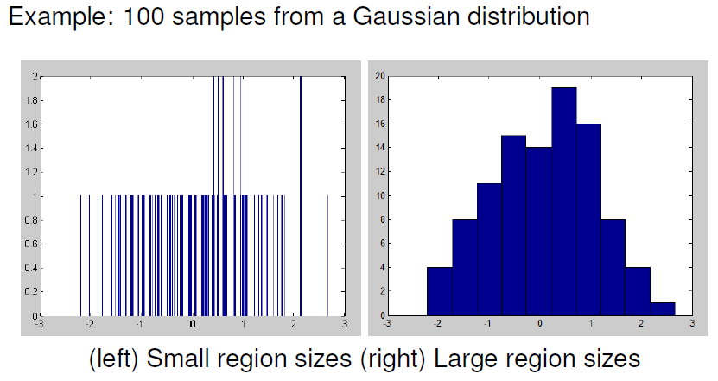
Histogram Estimation

Slide 14
Parzen Window Estimation
Aside from the problems mentioned before, the most obvious flaw in the histogram estimation approach is that we assume that the PDF p(x) is constant over each region.
Solution: the Parzen Window estimation approach does away with predefined regions and bin counting！
Advantages:
  No need to predefine region sizes
  Estimated PDF is ALWAYS continuous.
  Method is origin-independent.

Slide 15

Parzen Window Estimation
Fundamental idea:
  Every sample x_{i} locally influences the estimated PDF in the vicinity of x_{i}
  In other words, since we observed x_{i}, the PDF there can’t be too small; and if we see lots of samples in an area, then we expected the PDF to be correspondingly larger.
  Given this mentality, the estimated PDF is then the sum of the contributions from each sample:
  Where Φ is a window function which controls how each observed sample influences the PDF.

Slide 16



Properties of window function
Window function must be normalized:
To change the locality of influence of a sample, we may wish to stretch or compress the window function:
where h is a scaling factor.
To keep things normalized:

Slide 17

Parzen Window Estimation
Given N samples {x1,……,xN}, the Parzen Window estimation of p(x) is:
Common window functions include: rectangular, triangular, Gaussian and exponential.

Slide 18
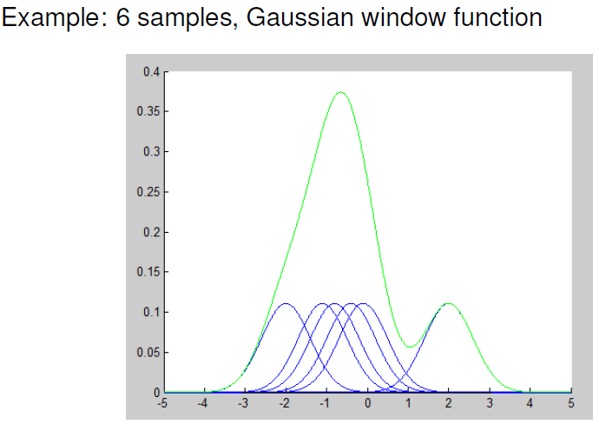
Examples

Slide 19
Scaling factor
One drawback: we still need to choose a window function and scale factor h
As a general rule, one option is to try h=K/√N for some constant K.
For small N, the constant K is important:
  If it is too small, the estimate is noisy with sharp peaks at the samples
  If it is too large, the estimate is smeared with low resolution.

Slide 20
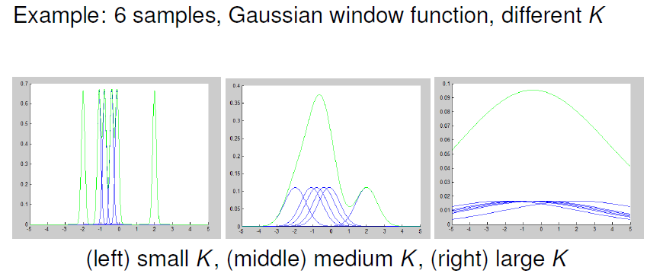
Scaling factor

Slide 21
KNN estimation
In histogram and Parzen Window methods, we fix the region size/window function width
This explicitly controls the resolution along the x-axis, and the resolution along the PDF axis is data dependent.
In the KNN method, we instead fix the number of samples M, and determine the size of region required at each point to enclose this many samples.
Therefore, this explicitly controls the resolution along the PDF axis, and the x-axis resolution becomes data dependent.

Slide 22

KNN estimation
To compute he KNN estimate of p(x):
Create an interval [x-α , x+ α] centered around x
Increase α until it contains a suitable number of observations M
Compute estimate of p(x) as:
where R(x) is the smallest region, centered around x which encloses M sample points.

Slide 23
KNN estimation
Frequently we set M=√N, in which case the kNN method has no free parameters.
If sample density is high, |R(x)| will be small, and the estimate will have high resolution where it is needed.
If sample density is low, |R(x)| will be large, and resolution will be low which is probably acceptable in sparsely populated regions.
Main advantages: avoids setting p(x) identically to zero in regions which happen not to have any samples, but instead results in a more realistic non-zero probability.
Disadvantage: estimated PDF is highly “peaked” and non-normalized.

Slide 24
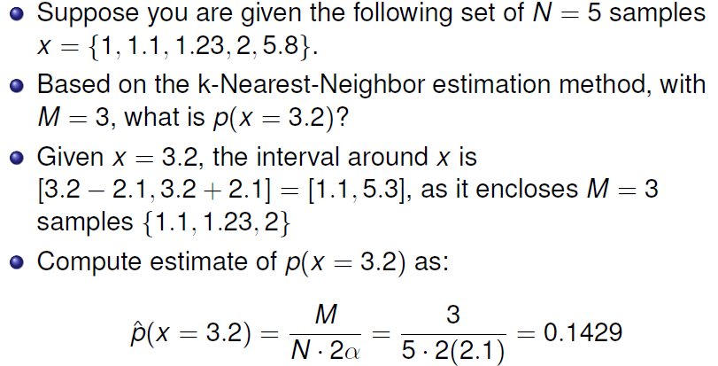
KNN: example

